Slide 1
Designing and Implementing a Secure Network Topology Using GNS3
Presented by:
Anirudh C M
Chandan T O
Mentor:
Col Jerry Miller
Dr. S S Iyengar

Slide 2
Overview
Introduction
Problem Statement
Research Question and Hypothesis
Objectives
Research Methodology
Gantt Chart
Topology
Attack on Ubuntu
Attack on Metasploitable-2
Next steps
Conclusion

Slide 3
Introduction
In today's digitally interconnected world, network security has become a paramount concern for individuals and organizations alike. The constant evolution of cyber threats necessitates robust and adaptable network infrastructures. This project aims to address this challenge by designing and implementing a secure network topology using the powerful simulation tool, GNS3.

Slide 4
Problem statement
Virtual Network Topology Using GNS3: To design a custom topology, one from scratch and run it on a virtual machine.
Establish routing between subnets in topology.
The virtual network has several requirements.
There should be an attack subnet and a benign subnet that communicate with each other.

Slide 5
Hypothesis
A well-designed network topology, incorporating appropriate security measures, can significantly reduce the risk of successful cyberattacks. By simulating a complex network environment using GNS3, we hypothesize that it is possible to create a secure network configuration that effectively protects against common threats, such as unauthorized access, data breaches, and denial-of-service attacks.

Slide 6
objectives
To design, implement, and evaluate a secure network topology using GNS3 that effectively protects sensitive information from potential cyber threats by simulating real-world attack scenarios.
This objective will be achieved through the creation of attack and benign subnets, implementation of appropriate security measures, and analysis of the effectiveness of these measures in preventing unauthorized access and data breaches.

Slide 7
Research methodology
Design
Design: Create a network topology in GNS3 separating attack and benign subnets.
Configure: Set up routers, switches, and firewalls with appropriate IP addresses and routing protocols.
Secure: Implement security measures like firewalls, ACLs, and intrusion detection systems.
Test: Simulate attacks to evaluate the effectiveness of security measures.
Analyze: Assess the project's outcome and identify areas for improvement.
Configure
Secure
Test
Analyze

Slide 8
Gantt chart
Week 1
Week 6
Week 10
Research Project
Develop Research Proposal and obtain approval
Defining the objectives
Setting up the testing environment
Evaluatiuon and Reporting
Presentation
Research Report

Slide 9
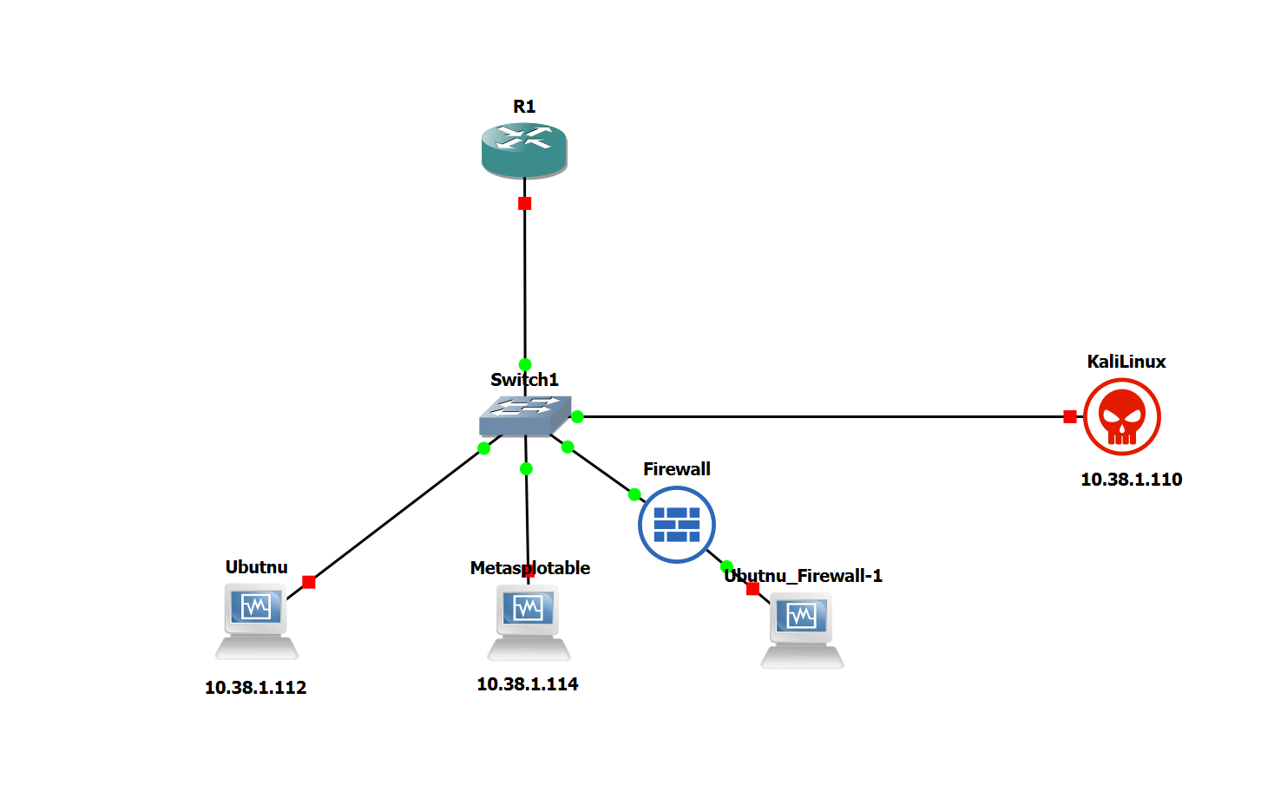
Topology
In the presented topology we have Kali Linux as attacker machine and we will be attacking machines like Ubuntu, Metasploitable-2 which is a web-server and we have also included another ubuntu machine which has a firewall which which will protect that machine against attacks like DOS, SSH Brute force and many more.

Slide 10
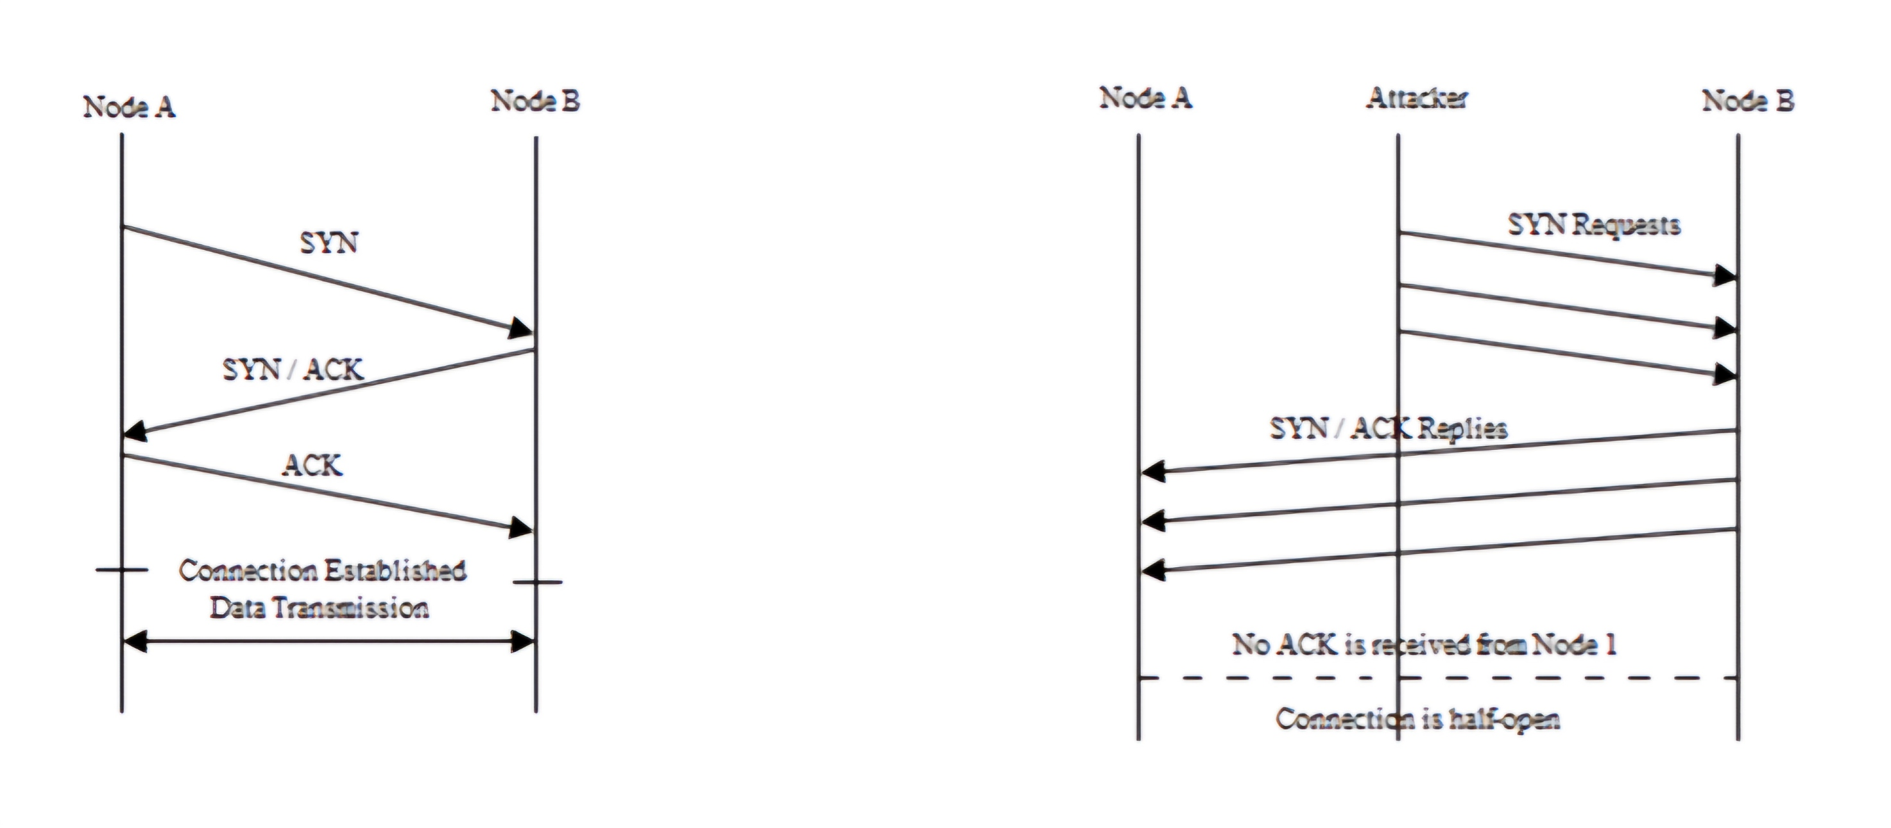
How does DOS attack work

Slide 11
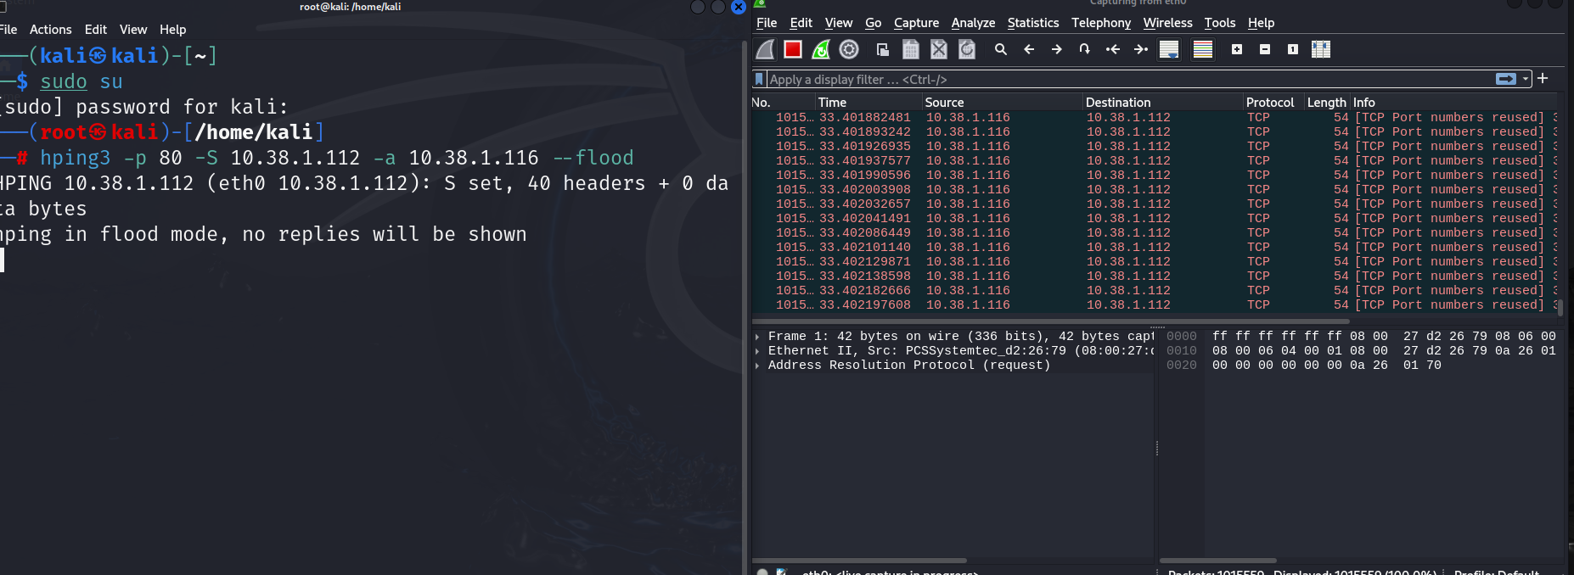
Attack on ubuntu

Slide 12
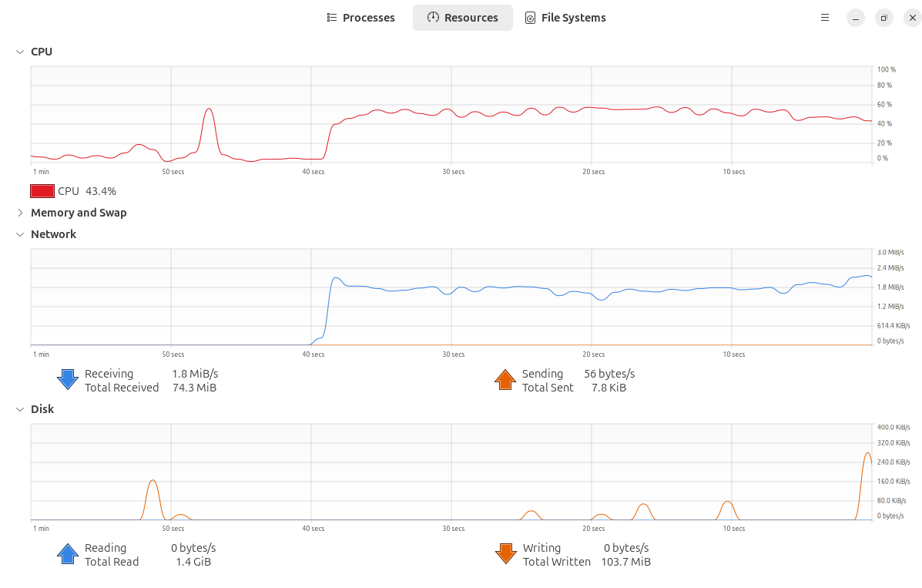
Attack on ubuntu
Graphical visualization of affect of attack on Ubuntu

Slide 13
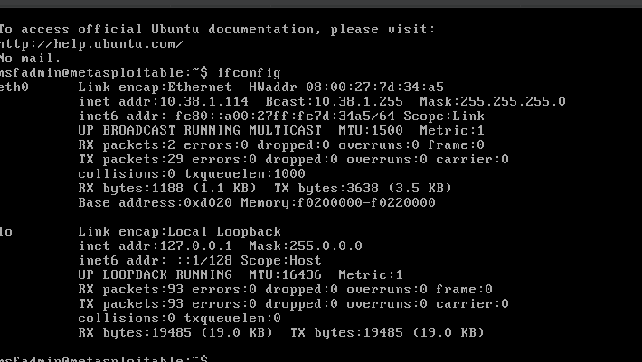
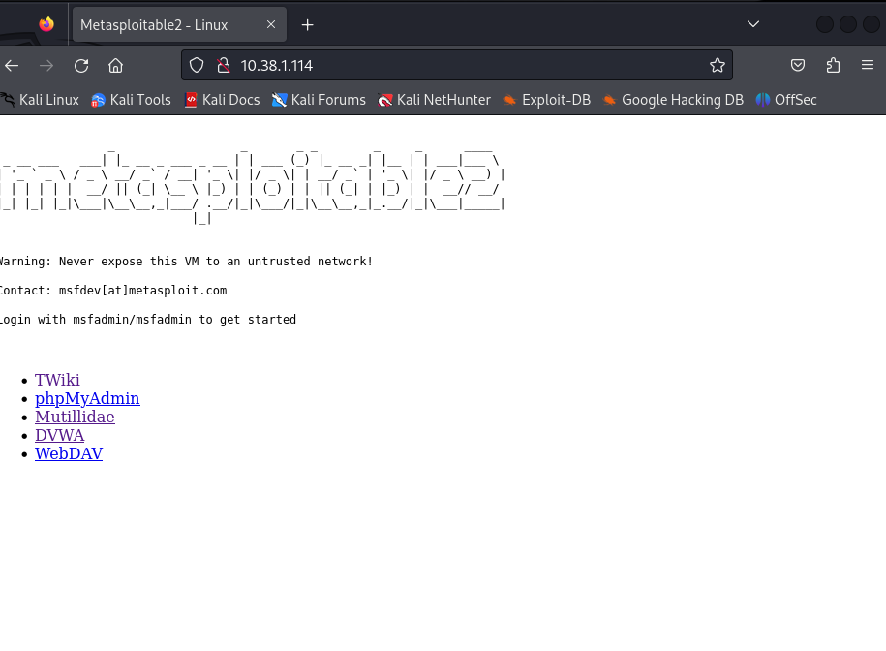
Attack on Metasploitable-2

Slide 14
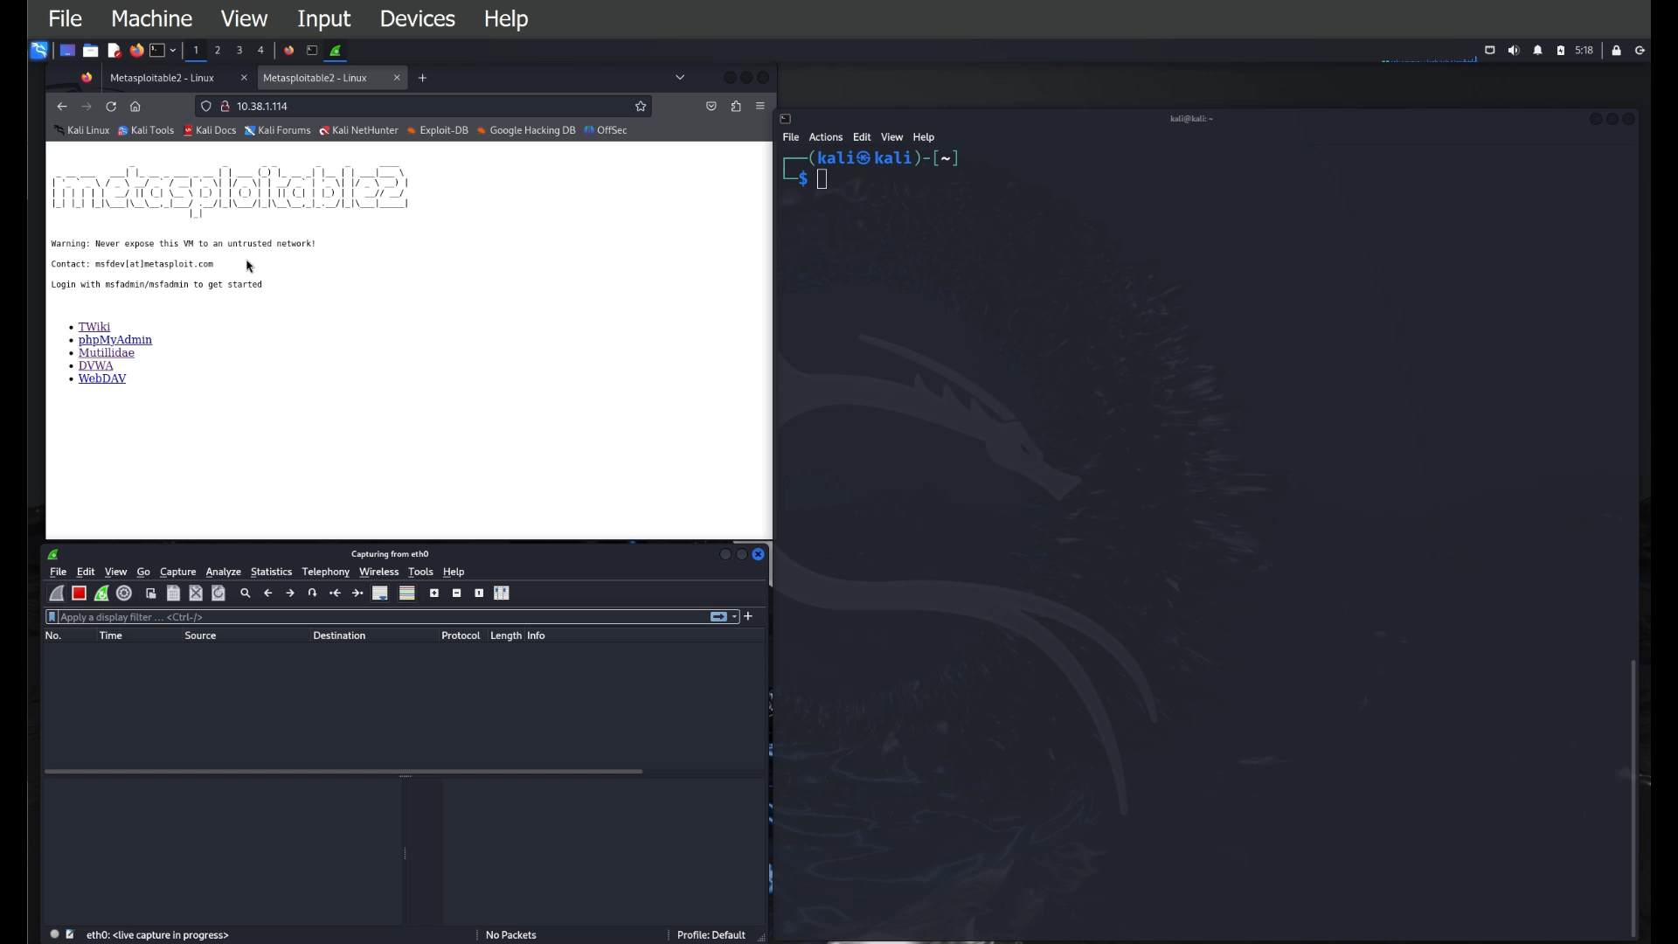
Attack on metasploit 2

Slide 15
Next steps
A successful DoS attack was conducted against both Ubuntu and Metasploitable-2 systems, resulting in the complete unavailability of the Metasploitable web server.
Our future steps involve installing and configuring a firewall on our Ubuntu system to enhance its security by controlling incoming and outgoing network traffic, thereby protecting it from various attacks.

Slide 16
conclusion
The successful design and implementation of a secure network topology using GNS3 has demonstrated the feasibility of creating a robust and protected network environment within a simulated setting. By incorporating various security measures such as firewalls, intrusion detection systems and access controls, we will be able to mitigate potential threats and vulnerabilities. This project serves as a foundation for understanding and applying real-world network security principles, providing valuable insights for future network design and implementation efforts.

